Slide 1
O-list Ecommerce
Mini-Project
Done by: Samuel Tan Zhi Wei U2020677G
Sim Kwan Hong Davis U2020429E
Isaac Tan Jun Hong U2020337B
Notes:
Good morning Prof and fellow classmates, my name is samuel and these are my groupmates, davis and isaac.

Slide 2
Problem Formulation

Slide 3


Problem Definition:
What can a seller do to get good customer reviews? (customer satisfaction)
Notes:
For our CZ1115 project, we chose the olist ecommerce dataset as our dataset of choice, We wanted to find out what can a seller do to get good customer reviews, this means their customer is satisfied and purchasing from said seller left a good impression.
Customer satisfaction is important for a multitude of reasons, it has been proven that customer satisfaction is is a leading indicator of customer loyalty and increase revenue, all of which are important to a seller’s success.

Slide 4
Data Cleaning

Slide 5
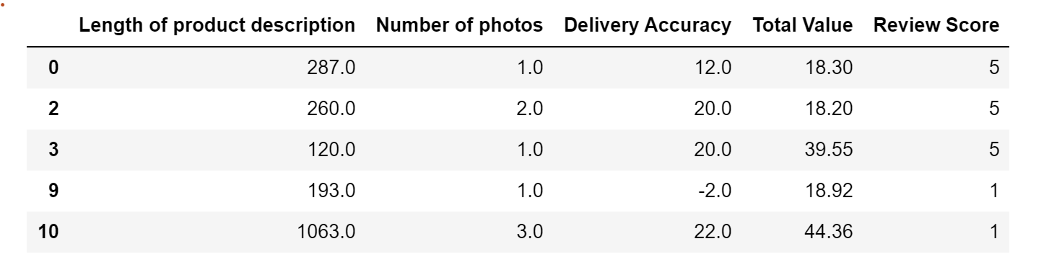

Final output of the variables used.
Merging of the data
Dropping all the rows that contains NA values
Extract Variables that we are using to solve our problem.
Notes:
By merging the Columns of the various datasets into one and dropping all the rows that contains the NA values. After which we extract the variables that we are going to use in order to provide a solution to our problem as shown above by the final output.

Slide 6
Data Visualization

Slide 7
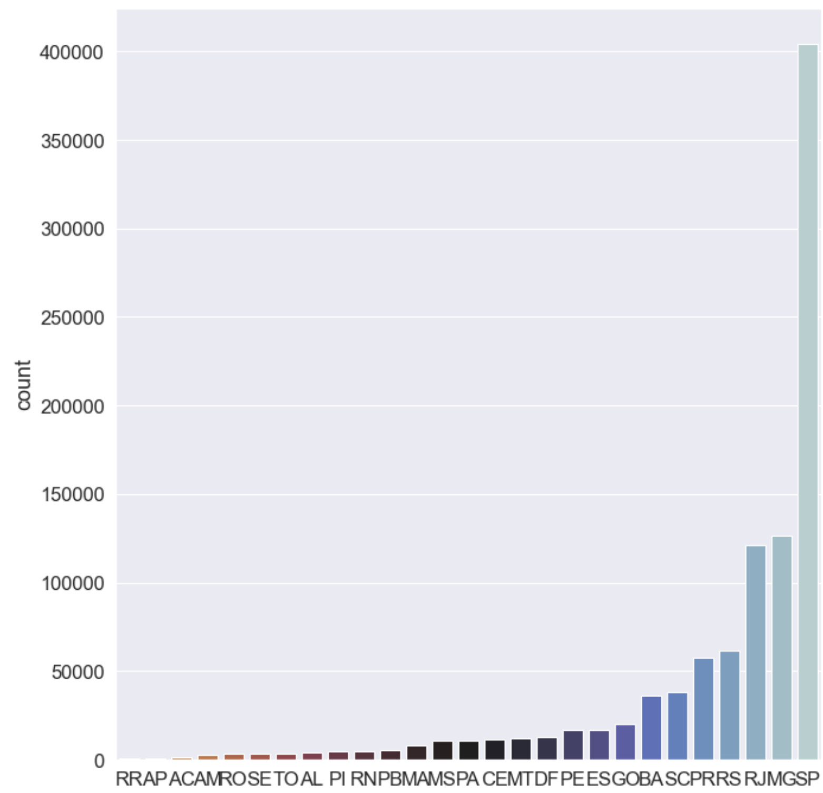
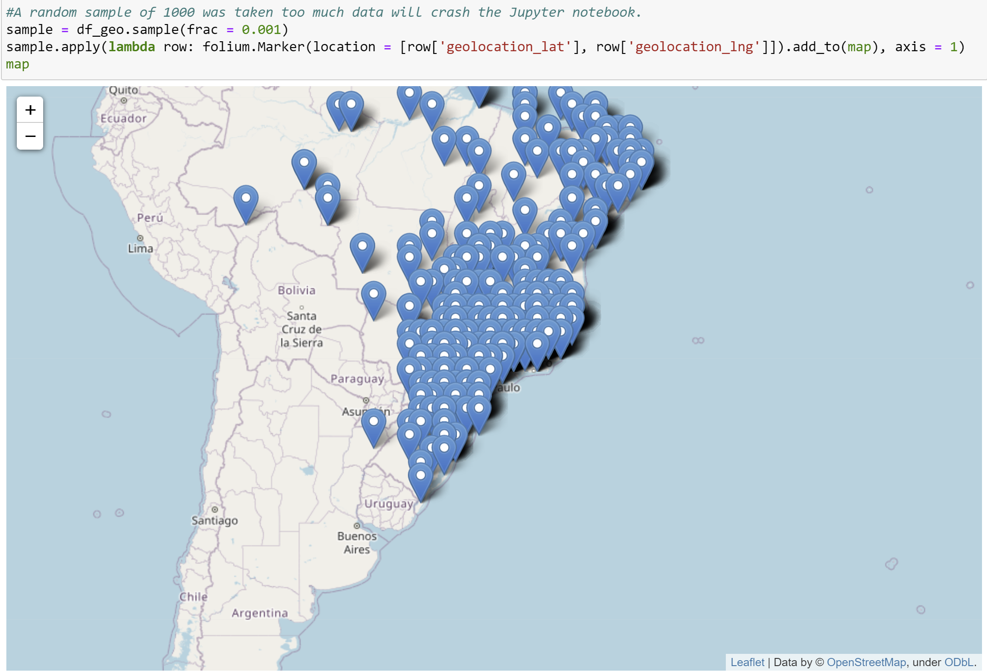
Exploring geolocation
Notes:
So let us look at the geolocation data firstly, from what we can see that most of the sellers are based on Sao Paulo so in this case we could maybe see if the distance between the buyer and seller would affect the review score. We thought of using this data as we saw the majority of sellers was based in Sao Paulo but it was not very useful in the end therefore this data was not used.

Slide 8
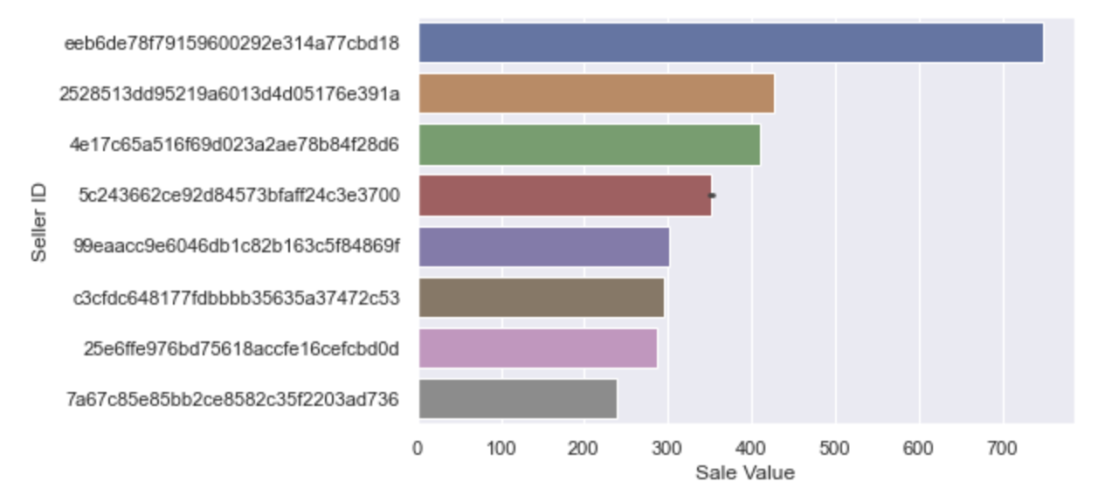
Exploring each seller’s sales
Notes:
So now, lets try to predict each seller’s success based on the Sale Value. Sale value is the number of sales each seller has. We tried to predict based on Sale Value but it did not have very good predictors therefore we didnt use it in the end.

Slide 9
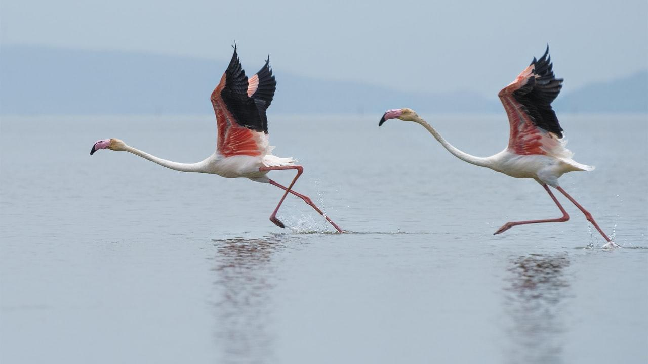
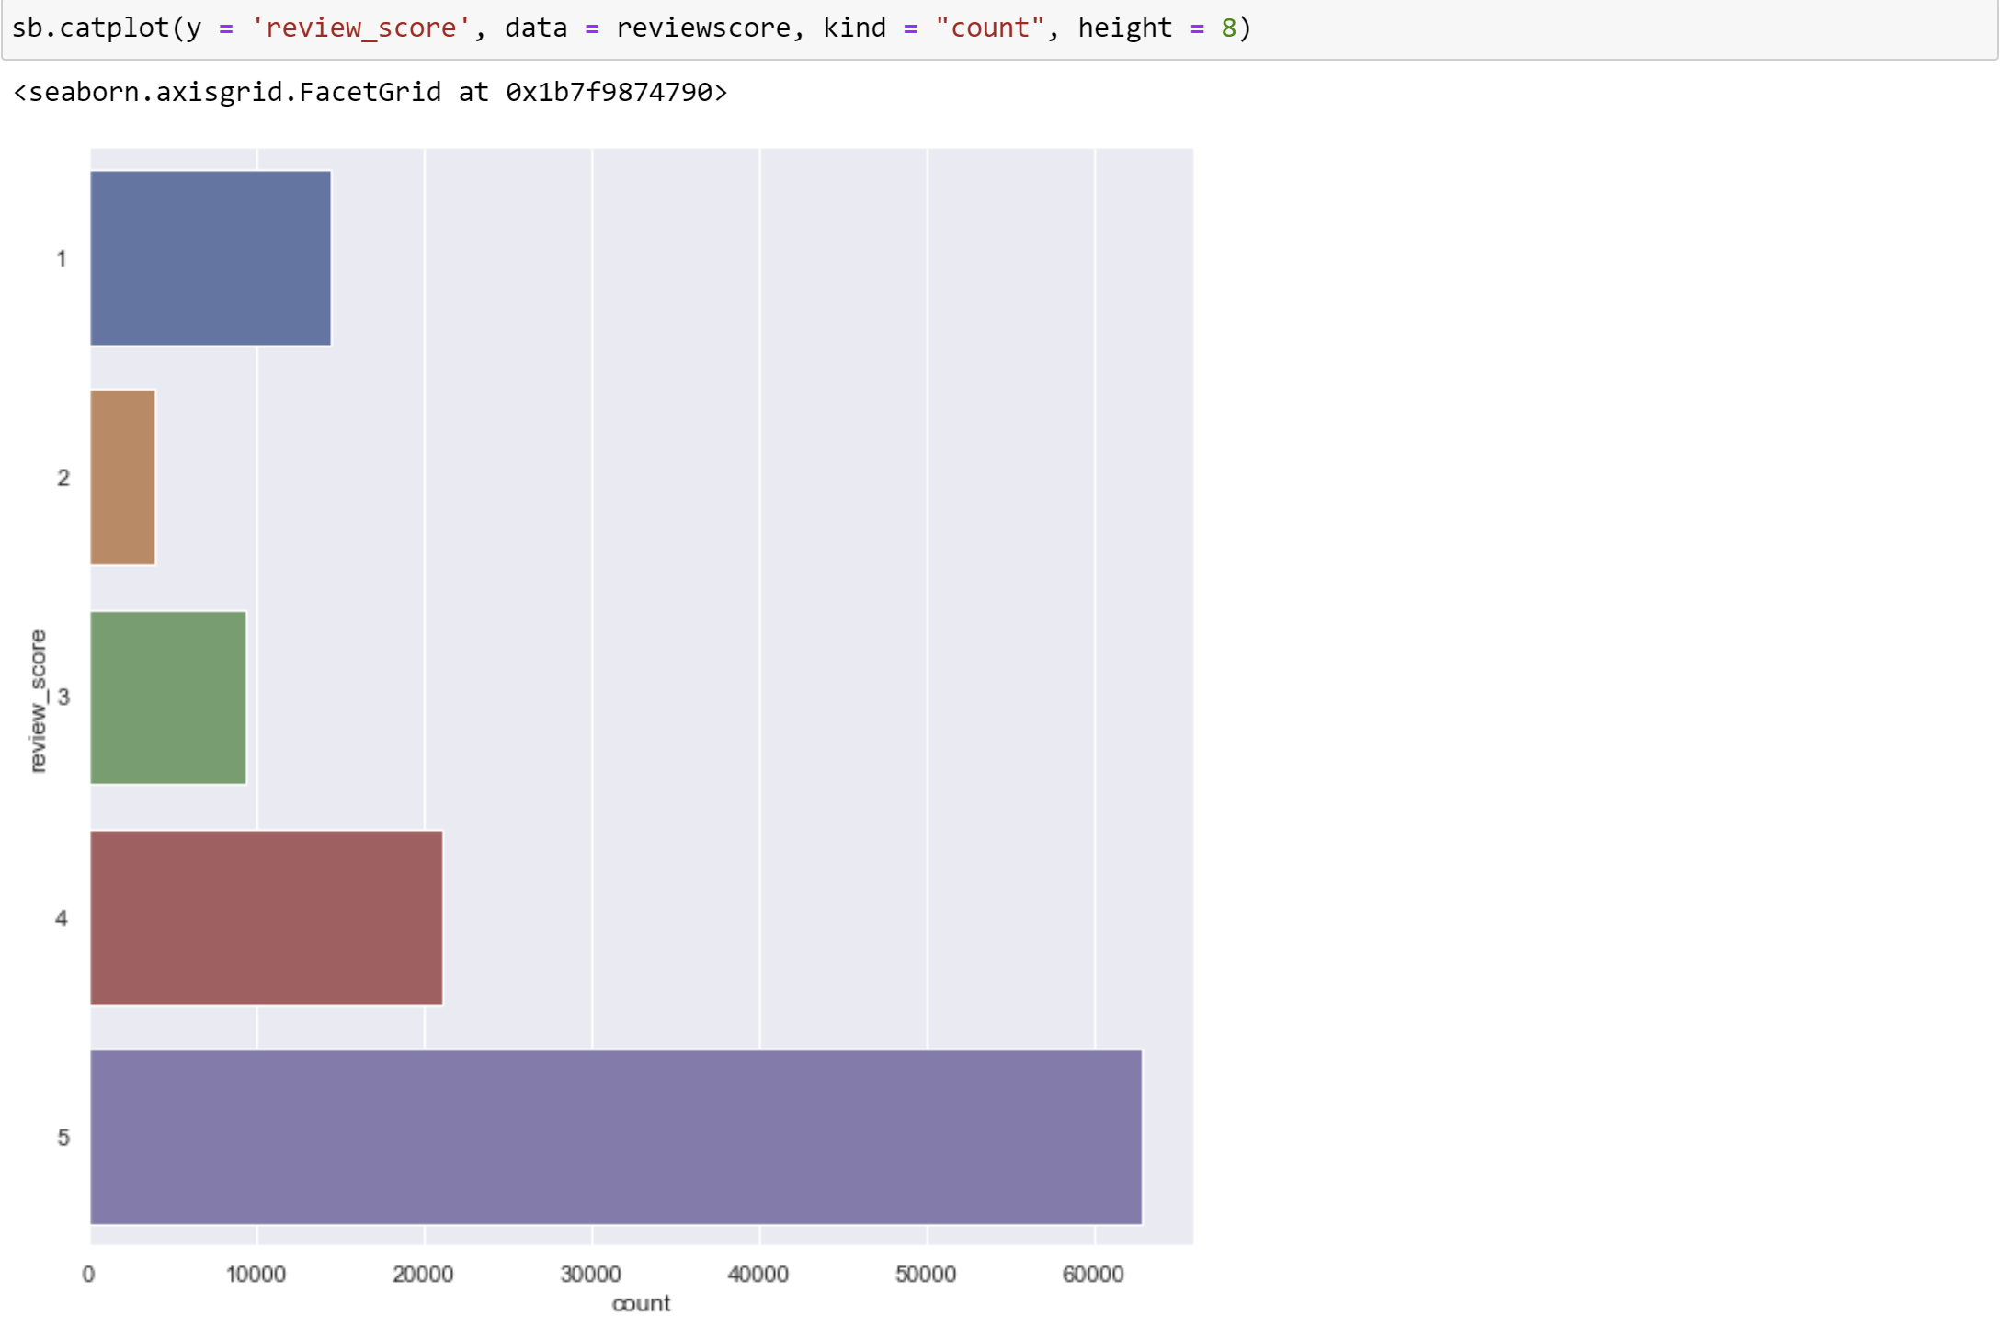
Exploring review score
Notes:
However we encountered more success here in predicting review score. So lets explore the review score variable. From what we can observed from the catplot above most of the customers have a high review score and 4 and 5 meaning that most of the customers are satisfied with their purchases but there are still a certain group of people that are still unhappy with their purchases given a significant number of customers giving the review score of one.

Slide 10
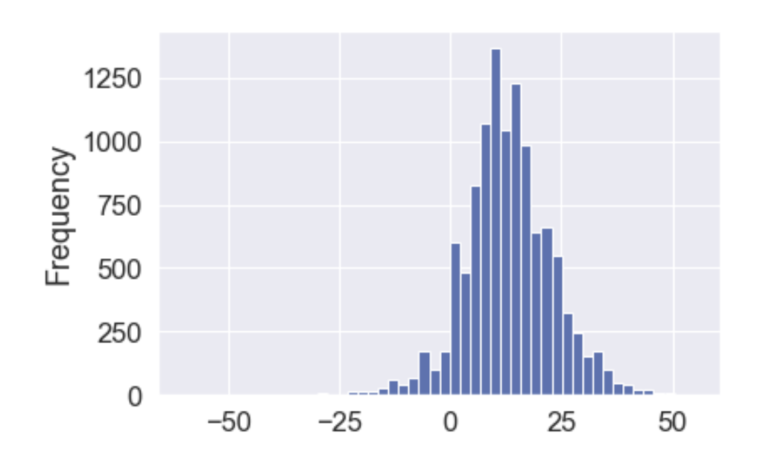
Efficiency of delivery
Notes:
Now we see that there is the actual delivery date column and the estimated delivery date column that we find that its more useful in predicting review score. So lets take a look at the frequency of the difference data which is gotten from using the subtracting the actual delivery date from the estimated delivery date to have a view how quickly they deliver their products to their customers as compared to the estimated date of delivery.
Delivery Accuracy is gotten from the difference from the order estimated delivery date subtract the actual delivery date.

Slide 11
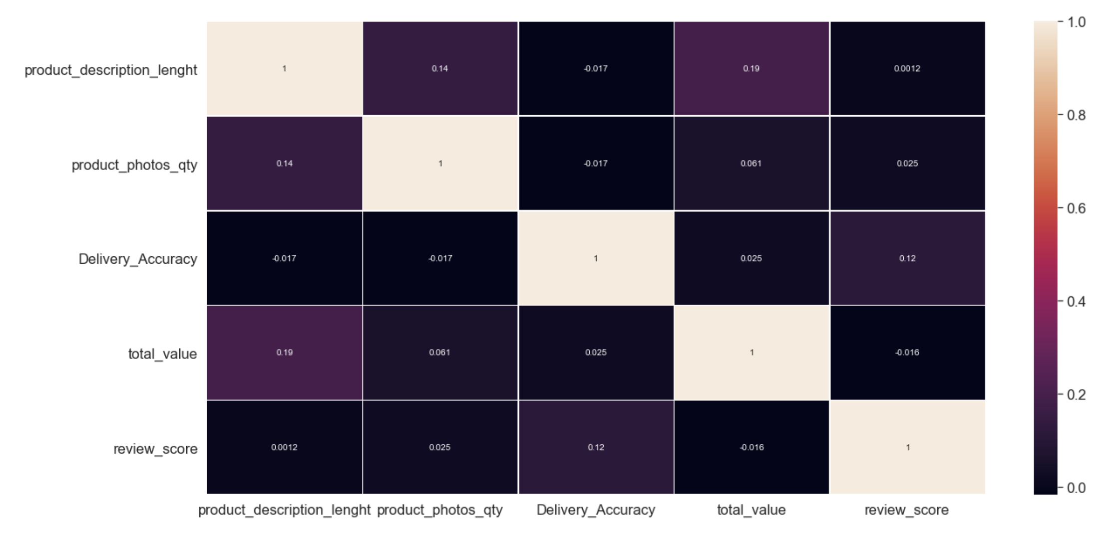
Correlation of the different variables
Notes:
Based on the heatmap generated, we can see that the other 4 variables that we are currently using have a very weak correlation when compared to the variable of review score

Slide 12

Machine Learning
Notes:
For our machine learning portion, before i start talking about our models I shall explain more about how we transformed our original data

Slide 13
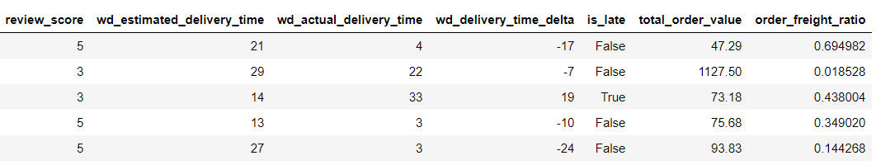

The new columns we obtained from the existing columns using FeatEng
Notes:
This was something we got inspired by from one of our references which helped us to add more columns. By transforming our existing data to give a better correlation which in turn will help our ML model to predict review score more accurately. As can be seen we included 4 new columns called is late, delivery time delta, total order value and order freight value.

Slide 14
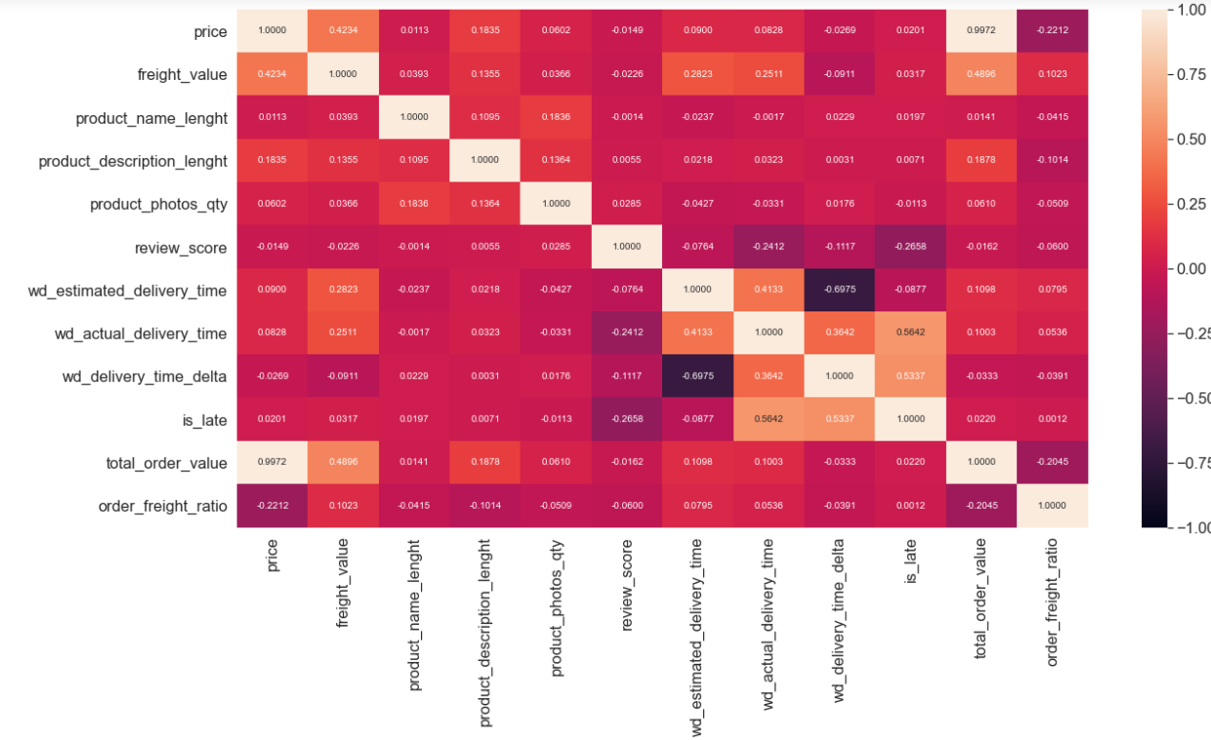
Notes:
With the addition of the new variables we can see from the new heatmap we have that now we are able to find variables with slightly better correlations than just the original columns. Now we these new columns we can dive right into our machine learning

Slide 15

Linear Regression
Classification Tree
Random Forest regression
2
R : 0.002
R : 0.089 (after data transform)
2
Accuracy: 0.5335
2
R : 0.897
Notes:
At first, we tried using linear regression as well as classification as these were the tools and technique taught in this course but after trying them. We found that Linear Regression would not work as the R^2 is really bad even after transforming the data. Classification tree was next and it was not as bad given its accuracy but we wanted to the prediction to be more accurate and at the same time we wanted to try a new model not taught before. We eventually settled on Random Forest Regression which was able to give us a very high R^2 of 0.897. We aimed to use random forest regression to help accurately predict review scores

Slide 16
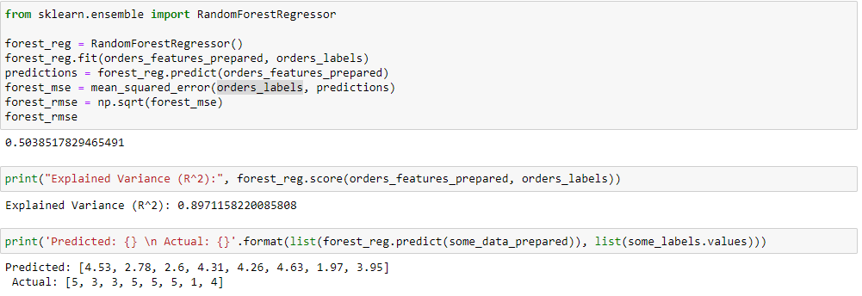
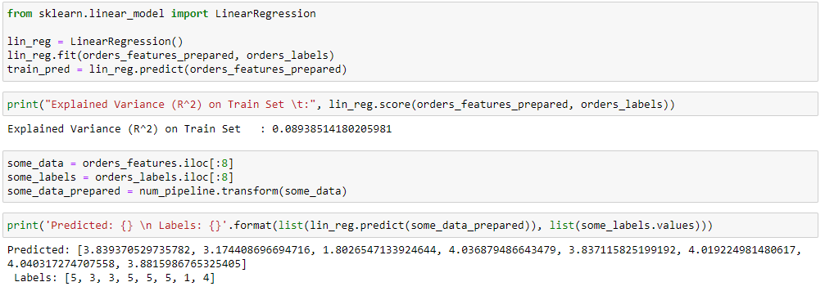
Random Forest VS Linear Regression
1
2
3
Notes:
Here we have a snippet of 2 different models we used and tested. As can be seen in this comparison between the random forest regression model and linear regression, we were able predict the review scores rather accurately using random forest as compared to a normal linear regression which is not as accurate

Slide 17
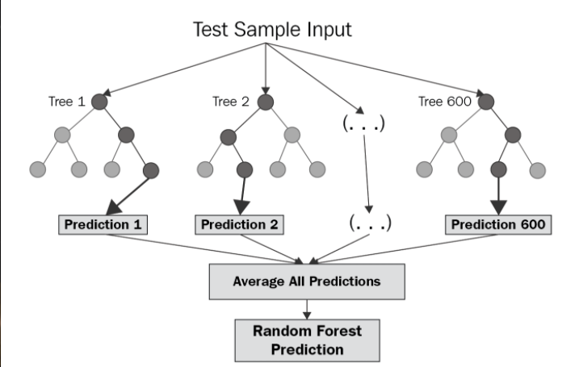
Random Forest Regression
Reason 1:
Linear regression did not work
Reason 2:
Classification tree worked but could be improved
Reason 3:
To try and learn a new model
Outcome:
Random Forest Regressor was a significant improvement after comparing the different models
Notes:
We chose to use random forest regression was that it gave a very high R^2 amongst the different model we tried and compared with. This model works by creating several decision trees for its prediction and was able to give a rather accurate prediction for review score, which enabled us to predict a user’s satisfaction given certain variables. As mentioned previously we did not use only the tools and techniques learnt in this course, as we also tried using random forest regression on top of linear regression and classification tree. We also tried something called feateng.

Slide 18
Final Outcome Analysis
STRENGTHS
Much improved prediction accuracy as compared to the other methods we used.
WEAKNESSES
MSE is rather high and prediction accuracy is not great (as a result of not THAT strong a correlation)
S
W
It is very clear that having an early estimated order and having an order arrive on time is a good idea (in contrast)
OBSERVATIONS
The dataset did not provide sufficient data for us to conclude anything definitively (with high confidence)
THINGS TO NOTE
O
T
Notes:
Using the swot analysis, our final outcome did well with much improved prediction accuracy as compared to the other methods we used. However, MSE is still rather high meaning, the prediction accuracy and correlation is not EXTREMELY high.
It is very clea that having an early estimated order and having an order arrive on time in contrast to other variables is a good idea to maintain good customer reviews.
We conclude that the dataset did not provide us with sufficient data for us to definitively conclude anything with a high amount of confidence

Slide 19
Recommendations
How do you satisfy your customer?
Deliver on Time (as estimated)
Deliver Early (estimated time is short)
Late Delivery (later than estimated)
Interesting to note:
Price is not a relevant factor
Notes:
Although intuitive, it is apparent that a late order will result in a bad review and fast delivery time will get you a good review, we know this as a common sense thing. But now we have data to visualize and definitively conclude that these are the largest contributing factors to review score.
Interestingly enough, price is almost a non-factor when evaluating the review score of an item. We would expect that an expensive item would leave a customer more likely to be dissatisfied with a product, however, that is not the case.

Slide 20
Work Allocation
Data Preparation: Samuel
Data Cleaning: Samuel & Isaac
Exploratory Data Analysis: Samuel & Isaac
Machine Learning: Samuel & Davis
Feature Engineering, Problem Formulation and Recommendation: Samuel
Slides: Samuel & Davis & Isaac
Video: Samuel
Notes:
As requested this is the slide dedicated to work allocation.
Davis - machine learning
Isaac - data cleaning and EDA
Lastly

Slide 21
Thanks!
Any questions?
Notes:
And we would like to thank the profs and TAs for reviewing our project we hope you enjoyed!

Slide 22
References
https://www.kaggle.com/andresionek/predicting-customer-satisfaction

Slide 23


Mobile project
Show and explain your web, app or software projects using these gadget templates.

Slide 24

Tablet project
Show and explain your web, app or software projects using these gadget templates.

Slide 25

Desktop project
Show and explain your web, app or software projects using these gadget templates.

Slide 26
Presentation design
This presentation uses the following typographies:
Titles: Fredoka One
Body copy: Nunito
Download for free at: https://www.fontsquirrel.com/fonts/fredoka https://www.fontsquirrel.com/fonts/nunito
You don’t need to keep this slide in your presentation. It’s only here to serve you as a design guide if you need to create new slides or download the fonts to edit the presentation in PowerPoint®

Slide 27
2. Extra Resources
For Business Plans, Marketing Plans, Project Proposals, Lessons, etc

Slide 28
Timeline
Blue is the colour of the clear sky and the deep sea
Red is the colour of danger and courage
Black is the color of ebony and of outer space
Yellow is the color of gold, butter and ripe lemons
White is the color of milk and fresh snow
Blue is the colour of the clear sky and the deep sea
JAN
FEB
MAR
APR
MAY
JUN
JUL
AUG
SEP
OCT
NOV
DEC
Yellow is the color of gold, butter and ripe lemons
White is the color of milk and fresh snow
Blue is the colour of the clear sky and the deep sea
Red is the colour of danger and courage
Black is the color of ebony and of outer space
Yellow is the color of gold, butter and ripe lemons

Slide 29
Roadmap
Blue is the colour of the clear sky and the deep sea
Red is the colour of danger and courage
Black is the color of ebony and of outer space
1
3
5
2
4
6
Yellow is the color of gold, butter and ripe lemons
White is the color of milk and fresh snow
Blue is the colour of the clear sky and the deep sea

Slide 30
Gantt chart
 | Week 1 |  |  |  |  |  |  | Week 2
 | 1 | 2 | 3 | 4 | 5 | 6 | 7 | 8 | 9 | 10 | 11 | 12 | 13 | 14
Task 1
Task 2 |  |  |  |  |  | ◆
Task 3
Task 4 |  |  |  |  |  |  |  |  |  |  | ◆
Task 5 |  |  |  |  |  |  |  |  | ◆
Task 6
Task 7
Task 8

Slide 31
Business Model Canvas
Key Partners
Insert your content
Key Activities
Insert your content
Value Propositions
Insert your content
Customer Relationships
Insert your content
Customer Segments
Insert your content
Key Resources
Insert your content
Channels
Insert your content
Cost Structure
Insert your content
Revenue Streams
Insert your content

Slide 32
Funnel
AWARENESS
Insert your content
DISCOVERY
Insert your content
EVALUATION
Insert your content
INTENT
Insert your content
PURCHASE
Insert your content
LOYALTY
Insert your content

Slide 33
Competitor Matrix
HIGH VALUE 2
Competitor
Our company
Competitor
Competitor
LOW VALUE 1
HIGH VALUE 1
Competitor
Competitor
Competitor
LOW VALUE 2

Slide 34

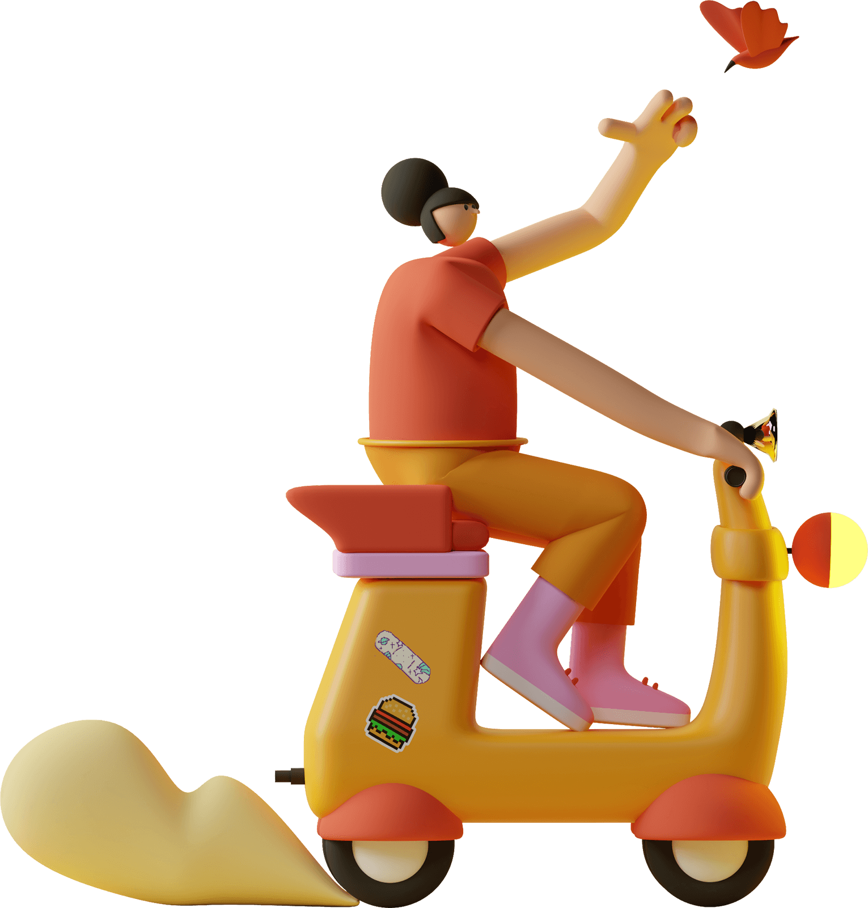



3D illustrations by Alzea Arafat

Slide 35
SlidesCarnival icons are editable shapes. This means that you can:
Resize them without losing quality.
Change fill color and opacity.
Change line color, width and style.
Isn’t that nice? :) Examples:
Find more icons at slidescarnival.com/extra-free-resources-icons-and-maps

Slide 36
Diagrams and infographics

Slide 37
You can also use any emoji as an icon! And of course it resizes without losing quality.
How? Follow Google instructions https://twitter.com/googledocs/status/730087240156643328
✋👆👉👍👤👦👧👨👩👪💃🏃💑❤😂😉😋😒😭👶😸🐟🍒🍔💣📌📖🔨🎃🎈🎨🏈🏰🌏🔌🔑 and many more...

Slide 38

Free templates for all your presentation needs
For PowerPoint and Google Slides
100% free for personal or commercial use
Ready to use, professional and customizable
Blow your audience away with attractive visuals

